Slide 1
Module 3.1 - Computer Vision
Introduction to Computer Vision

Slide 2
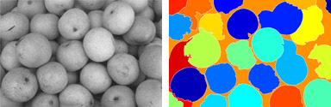
Computer Vision
Computer vision is the task of understanding the images captured by a camera
Vision tasks that are simple for humans to do, can be very difficult for a computer
For example, color each fruit a different color
Notes:
Computer vision, also known as machine vision, is the job of creating program and algorithms to extract useful information about images captured by a camera
For a robot, this could be distinguishing what areas around it are occupied by obstacles or recognizing which person is nearby
These tasks can often seem very simple and easy for humans, but to write a program to accomplish such tasks can be very difficult
Computers do not inherently have the years of visual experience nor the tactile experiential knowledge that humans have
Without a model of the world, determining the content of an image can be quite challenging

Slide 3
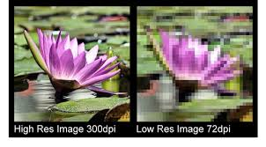
Images and Image Representation
Camera images are 2-dimensional arrays of pixels
Each pixel is a ‘picture element’
Resolution is the width x height (e.g. 640x480, 1024x768)
Another image statistic is the number of pixels used to represent the image
1 megapixel or 2 megapixels
The higher the resolution, the more information available, but it takes more time to processes higher resolution images
Notes:
An image captured by a camera is a 2-dimensional array of pixels
Pixels are discretized picture elements which when put together form the original image
The higher the resolution, the more visual detail is captured in the image, but it does take more time to process a higher resolution image
The image captured by the Jet camera is 640x480, which is .3 megapixels. Even this resolution can take some time to process, so sometimes it is necessary to convert the image to a lower resolution.

Slide 4
Color Images
Color images can be represented with 3 values per pixel
A common representation is RGB (Red, Green, Blue)
Each color value is an 8-bit number between 0 and 255
Black is all 3 values being 0
White is all 3 values being 255
To represent this type of image, there are 3 parallel 2-D arrays
One 2-D array for each color
Notes:
Color images are represented as 3 values per pixel
A common representation has 3 bytes for each pixel and each byte represents the Red, Green, and Blue components of the pixel color
Each color component can then be represented as a value from 0 to 255
This is often called 24-bit color (3 x 8 bits)
Brighter colors will have higher component values. White is all 3 values being 255. Black is all 3 values being 0.
For example, a 640x480 image will take 921,600 bytes (640*480*3 = 921,600)

Slide 5
Binary Images and Grayscale
Grayscale image have each pixel representing a single intensity value
A value of 0 is black (lowest intensity)
A value of 255 is white (highest intensity)
These images look like a typical black and white image
Average the RGB values to convert color to grayscale
Binary images have each pixel either on (1) or off (0)
These images are useful as an intermediate representation for other operations
Notes:
Grayscale image are what we typically think of as black and white images
The difference here is that the color components are represented as a single value. For example, this could be a single 8-bit value
0 is black and 255 is white.
Converting a color image to grayscale is done by averaging the 3 color channels.
When color is not needed, these images can be faster to process.
Binary images are images where the pixel value is a 1 or a 0.
These images can be useful intermediate representations when detecting edges or lines.

Slide 6
Capturing an Image in OpenCV
OpenCV is the open-source computer vision library that provides many pre-built vision operations
To subscribe to the ROS that publishes images
To capture a new image
image_transport::Subscriber sub;
image_transport::ImageTransport it(nh);
sub = it.subscribe("/cv_camera/image_raw", 1, imageCallback);
void imageCallback(const sensor_msgs::ImageConstPtr& msg)
{
cv::Mat src;
src = cv_bridge::toCvShare(msg, "bgr8")->image;
Notes:
OpenCV is the computer vision library that is used on the JetBot to process captured images.
To create a node that subscribes to the raw image messages from the camera, use the code shown here
‘nh’ is the NodeHandle for this process
‘sub’ is a subscriber to the camera raw images
Whenever a new image is captured, the ‘imageCallback’ function is automatically called
Here we have the new image stored into an OpenCV matrix.

Slide 7
Edge Detection
Edges are important for human vision
Independent of lighting conditions
Easy to detect computationally
Edges can be used to find higher level features (lines, corners, curves)
Notes:
Edges are important low level images feature that are important for human vision
Edges have the property of being relatively independent of lighting. Whether an image is taken during the day or at night, the edge can still be seen.
Once you have information about an edge in an image, you can use that knowledge to detect higher level image features
Here we will look at how edges can be extracted from images

Slide 8
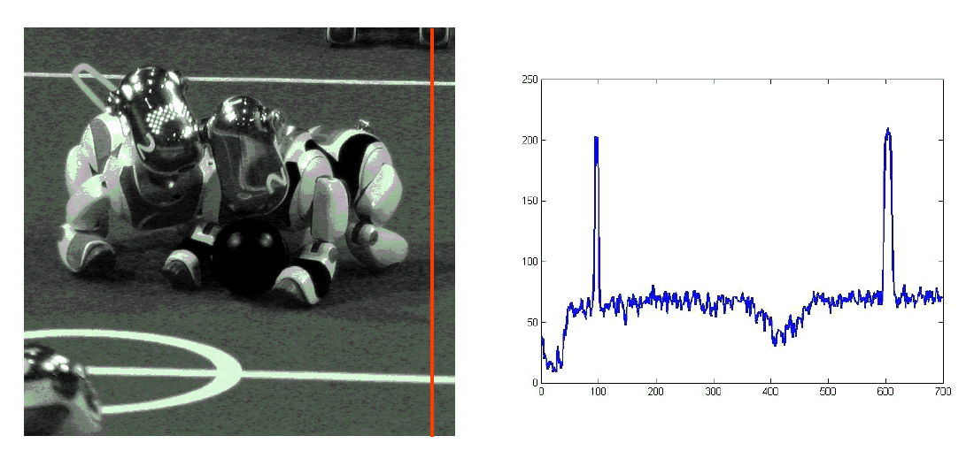
Characterizing Edges
Notes:
The picture on the left shows a grayscale image.
The red line on the image represents a particular column in the image. If you could plot the pixel values as you traversed the red line from the top to the bottom, you would see a graph similar to the graph on the right.
The top of the line covers a darker part of the image. When the line cut through the which lines of the playing field, the pixel intensity values form spikes in the graph
Whenever there are strong edges in an image, the edge shows up as a strong difference between neighboring pixels

Slide 9
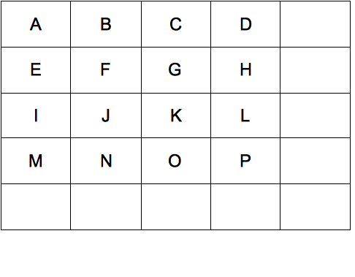
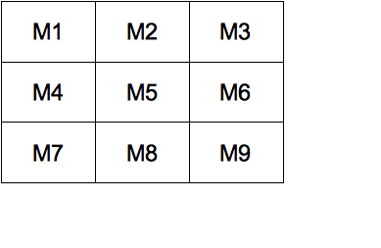
Convolution Masks
A convolution mask is an 2-d array of numbers applied to an image to transform the image pixel-by-pixel
Convolution masks are used in edge detection and other image processing applications
New F = (m1*A + m2*B + m3*C + ...... + m9*K) / S
Where S = | m1 + m2 + ..... + m9 |
If S=0, then set S=1
Notes:
A common operator in computer vision are convolution masks
In this example, the convolution mask is a 3x3 array of number M1-M9. Think of the convolution mask being applied over a 3x3 region of pixels with M5 being placed over the center pixel.
The computation for applying the convolution mask is shown in the computation of F. To compute the new F, multiply each mask value with the corresponding pixel, sum the values, and then divide by the sum of the mask values

Slide 10
Convolution Masks for Edge Detection
1 | 2 | 1
0 | 0 | 0
-1 | -2 | -1
1 | 0 | -1
2 | 0 | -2
1 | 0 | -1
Sobel edge
Intuition behind the horizontal Sobel mask
If the region is uniform grayscale, then the result of applying the mask will be 0
If there is a horizontal edge, then the result of applying the mask will be a large non-zero value
If there is a vertical edge, the terms will cancel out
Horizontal Edge
Mask
Vertical Edge
Mask
Notes:
Sobel edge detectors are represented as 3x3 convolution masks
There is a horizontal edge mask and a vertical edge mask.
The intuition behind the horizontal Sobel mask is that if there is a strong horizontal edge, such as the horizontal lines in the soccer image, then the result of applying the mask will be a large non-zero value
In the case of a vertical edge, the horizontal Sobel will not produce a strong value

Slide 11
Convolution Masks for Edge Detection
Steps to edge detection with the Sobel masks:
Apply the horizontal mask to image I to get image H
Apply the vertical mask to image I to get image V
Compute the gradient of each point
G(x,y) = (H(x,y)² + V(x,y)² )^{1/2}
Threshold the image into a binary image based on the gradient of each pixel
Notes:
In order to detect the edges in an image, we can apply the Sobel horizontal and vertical edge masks in the following manner
First, apply the horizontal mask to image I to obtain an image H. This image H only has high intensity values for horizontal edges.
Do the same operation with the vertical mask to produce an image V. The image has high intensity values for vertical edges.
Compute the gradient using pixel values from both image H and V.
Threshold the image by comparing the G(x,y) against a threshold. If the value is above the threshold, then set the value to 1 in a new binary image.
The resulting image will contain 1’s where there are edges and 0’s where there are no edges.
The results of this process can be seen in the next slide

Slide 12
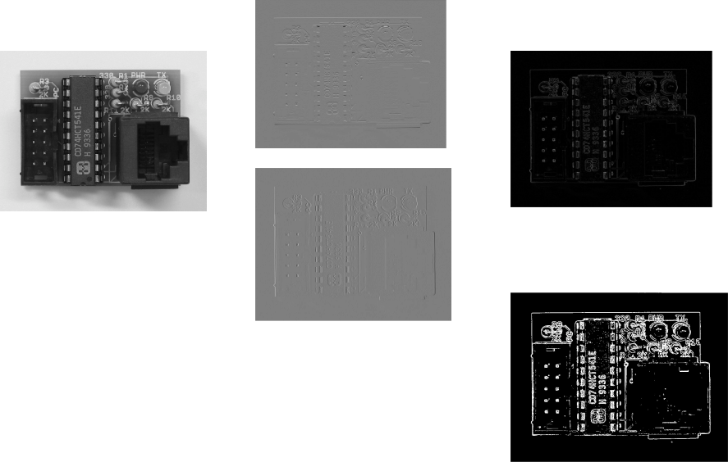
Convolution Masks for Edge Detection

Slide 13
The GPU Teaching Kit is licensed by NVIDIA and California Polytechnic State University under the Creative Commons Attribution-NonCommercial 4.0 International License.

